Slide 1
Gas leakage detector

Slide 2
Presented By
Nadim Hasan 2017100000103 Shakil Mia 2017100000086 Kamrun Nahar Luchi 2018200000055

Slide 3
OBJECTIVES
Detect Gas Leakage (like LPG leak, carbon-monoxide leak) or any such petroleum based gaseous substance that can be detected using MQ series Sensor.
When the gas is detected the alarm system is turned ON, the alarm get stop when the gas is under control or maintained at constant temperature.

Slide 4
Components
Components Details () {
Solderless Breadboard, Arduino Uno, MQ-2 GAS Sensor, Buzzer,

Slide 5
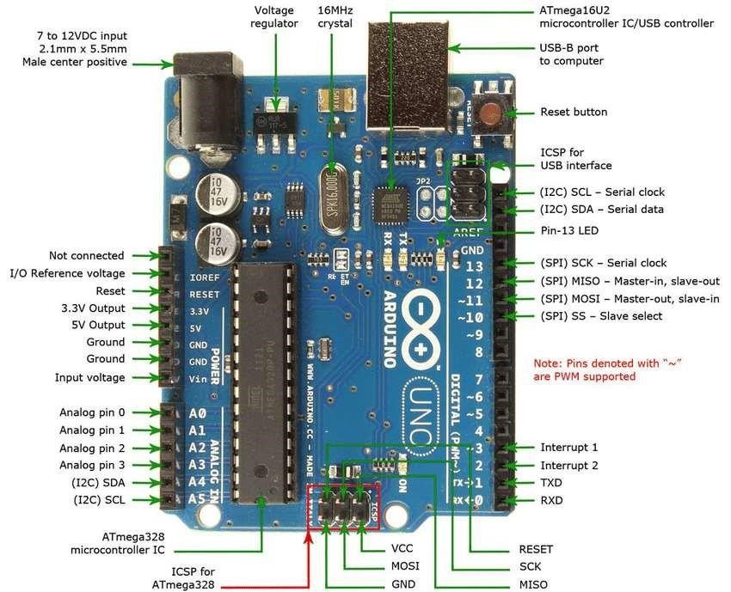
Arduino UNO
Open Source micro-controller
Based on ATmega328P
Developed by Arduino
Consists of digital and analog i/o pins
Has interface for expansion boards

Slide 6
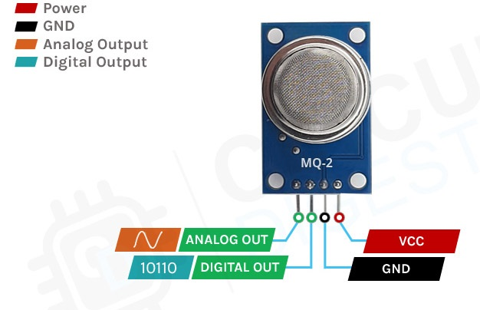
Gas sensor
Detects the presence of gases
Used as a part of safety system
Consists of Analog out, Digital out, VCC and GND pin

Slide 7
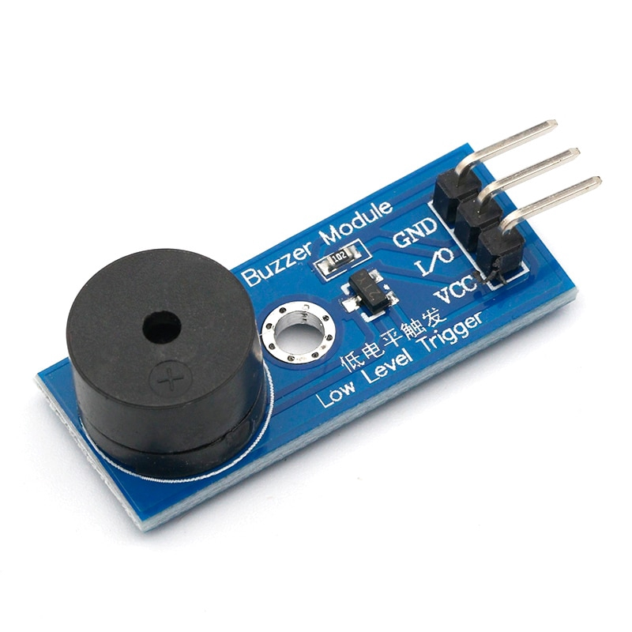
Buzzer
Audio Signaling device
Types: mechanical, electrical or piezoelectric
Consists GND, VCC and I/O pin
Use: alarm device, timers, training, confirmation of input (keystroke, mouse click etc.)

Slide 8
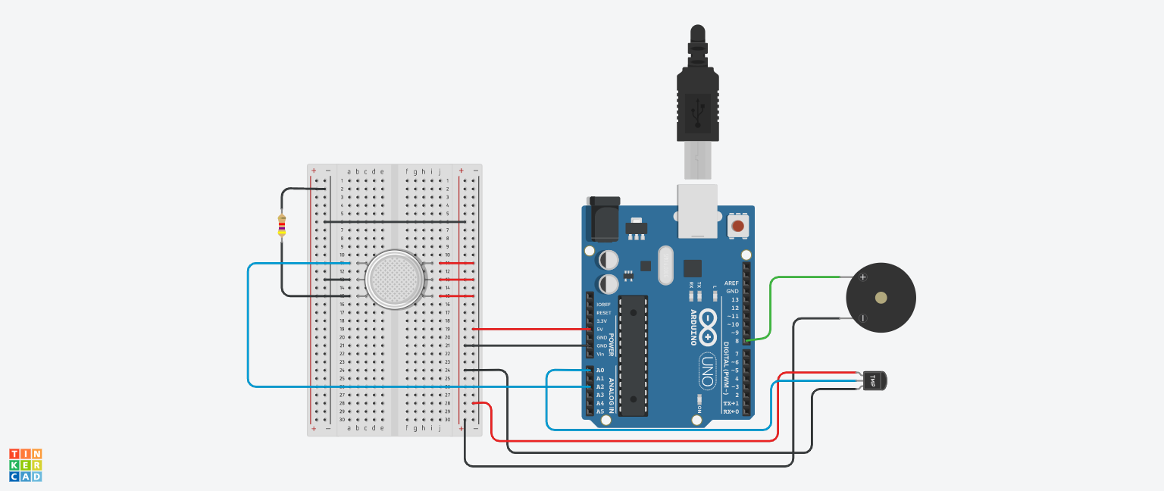
Circuit diagram simulation

Slide 9
Code
int i=0;
int test = 0;
int temperature;
int baselineTemp = 0;
int celsius = 0;
int gas_input = A2;
int gas;
int buzzer = 8;
int a,b;
void setup()
{
Serial.begin(9600);
}

Slide 10
Code
void loop()
{
a = temp();
b = gasMesure();
if(gas>30 && celsius>70){
tone(buzzer,200);
delay(100);
}
else{
noTone(buzzer);
}
delay(100);
}

Slide 11
Code
int temp(){
baselineTemp = 40;
celsius = map(((analogRead(A0) - 20) *
3.04), 0, 1023, -40, 125);
Serial.print(celsius);
Serial.print(" C, \n");
Serial.print(analogRead(A0));
Serial.print("\n");
return(celsius);
/*if(celsius>70){
tone(buzzer,200);
delay(100);
}
else{
noTone(buzzer);
}*/

Slide 12
Code
}
int gasMesure(){
gas = analogRead(A2);
gas = map(gas, 300, 750, 0, 100);
Serial.println(gas);
return(gas);
}

Slide 13
Pros
Help to aware people about gas leakage
Can prevent any kind of accident because of gas leakage
When sensor found there is leakage gas, the system will alarm loudly .

Slide 14
Conclusion
Technology make our daily life more and more easier but we also need safety. So, we use technology so that we can make our life more safe and sound. This project will help us to prevent any kind of gas leakage accident.

Slide 15
Thank you

